Slide 1
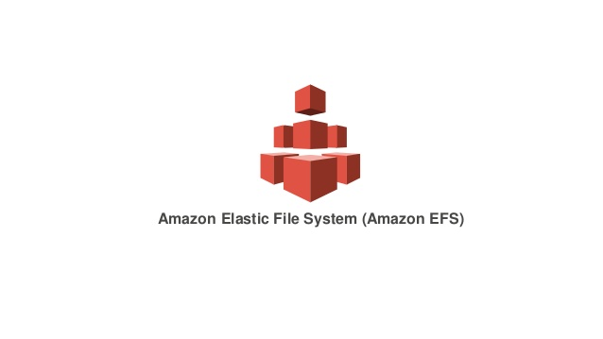

Slide 2
Elastic file system
Elastic file system is a file storage service for Amazon's Elastic Compute Cloud (EC2) instances.
Like EBS but EBS can only be attached to single Ec2 machine where as EFS can be shared between multiple Ec2 Devices
EFS is an easy way to use and provide a simple interface that allows you to create and configure file systems quickly and easily.
With EFS, storage capacity is elastic growing and shrinking automatically as you add and remove files so your applications have the storage they need, when they need it.

Slide 3
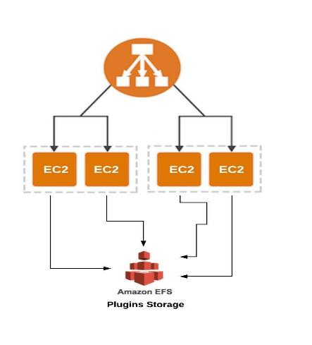
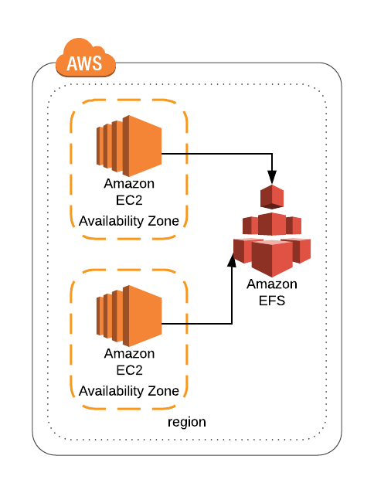
Elastic file system

Slide 4
Elastic file system
Supports a Network file system version 4 (NFSv4) protocol
You only pay for the storage that you use (no pre provisioning required.)
Can scale up to the petabytes
Can support thousands of concurrent NFS connections
Data is stored across a multiple Availability Zones within a region.
Read after Write Consistency.

Slide 5
Thank you

